Slide 1


VOICE BASED IMAGE EDITOR
Internship Project in association with Computer Society of India, Hyderabad.
Trainer: Krishna Teja, Packet Prep Team
Mentor: Dr.Sesham Anandh, Professor, MVSR College of Engineering
Team
G.Varun Kumar, Geethanjali College of Engineering and Technology
L.Jaya Krishna, Geethanjali College of Engineering and Technology
K.Nithesh Sai, Geethanjali College of Engineering and Technology

Slide 2

PROBLEM STATEMENT
In this modern world, image editor is not a hands-free technology.

Slide 3


Solution
If Image Editor is a hands-free technology, then image editing is much more easier

Slide 4

Functionality
Only authorized candidates can
open the application.
The user must upload image path of his/her choice and upload the image.
Through the voice commands given by the user the image is edited and displayed to the user.
ZIMCORE HUBS | DESIGN THINKING

Slide 5

USAGE

Slide 6

STEP 1
Run the application with
the following command
>python mainlayout.py

Slide 7

STEP 2
Users must register and login to access the application.

Slide 8

STEP 3
User should enter the path of the image file so as to upload it.

Slide 9
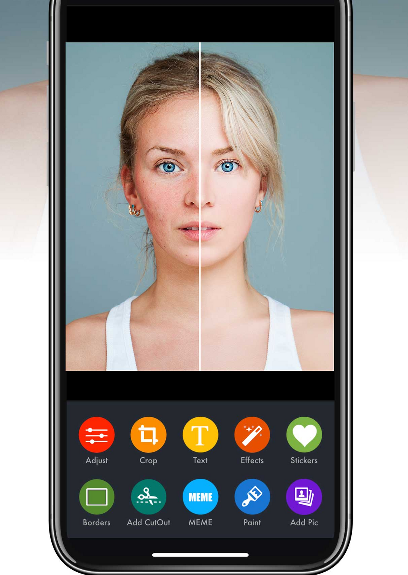
STEP 4
User can now edit the images by giving voice command according to the options given.

Slide 10
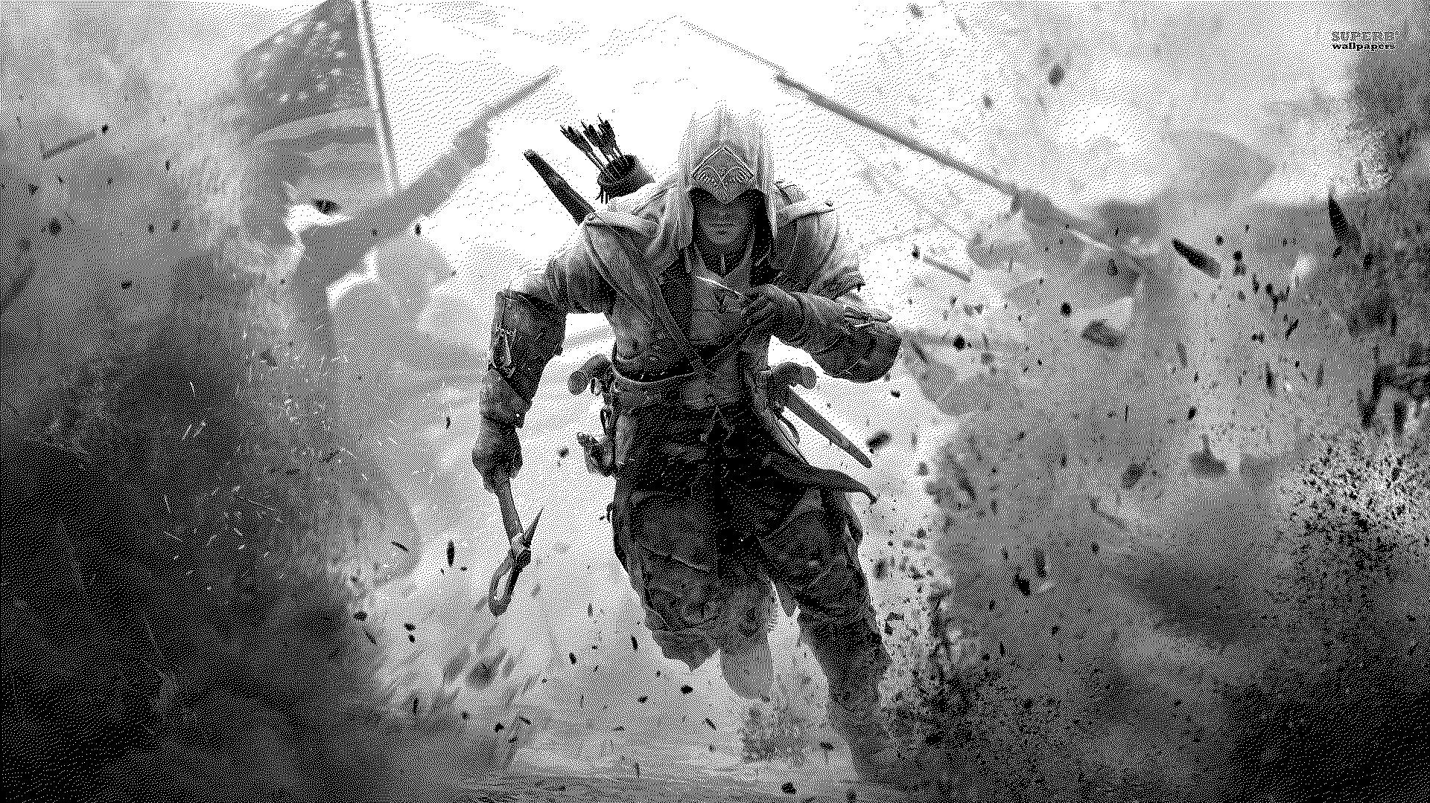
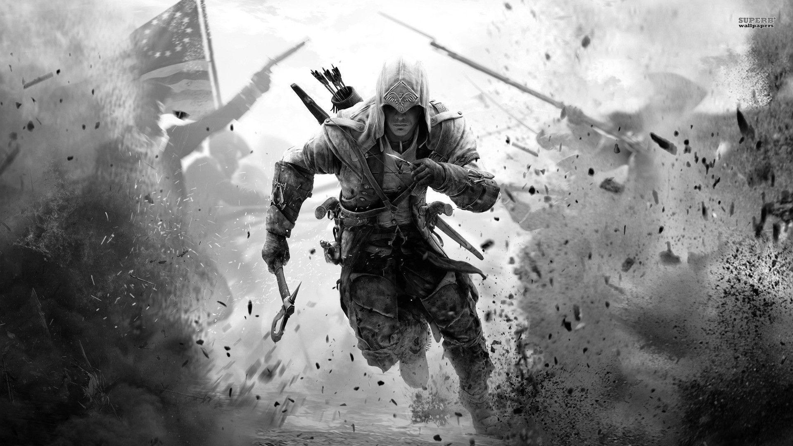
Black and White
Screenshots or Outputs in Color Window
Grayscale

Slide 11
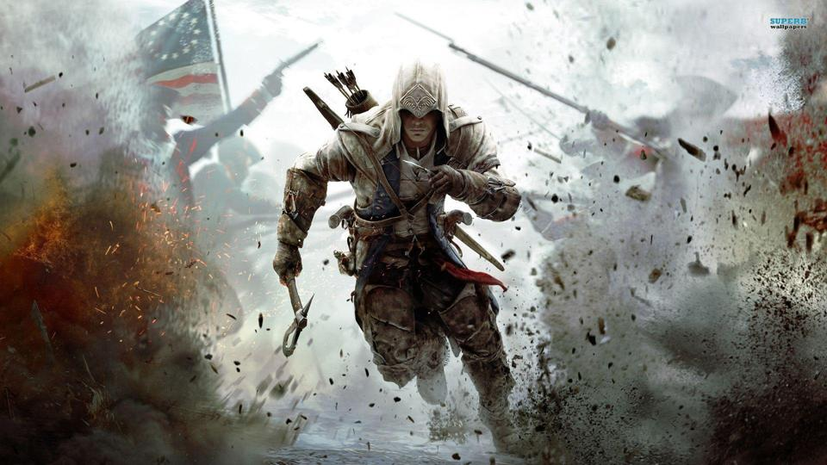
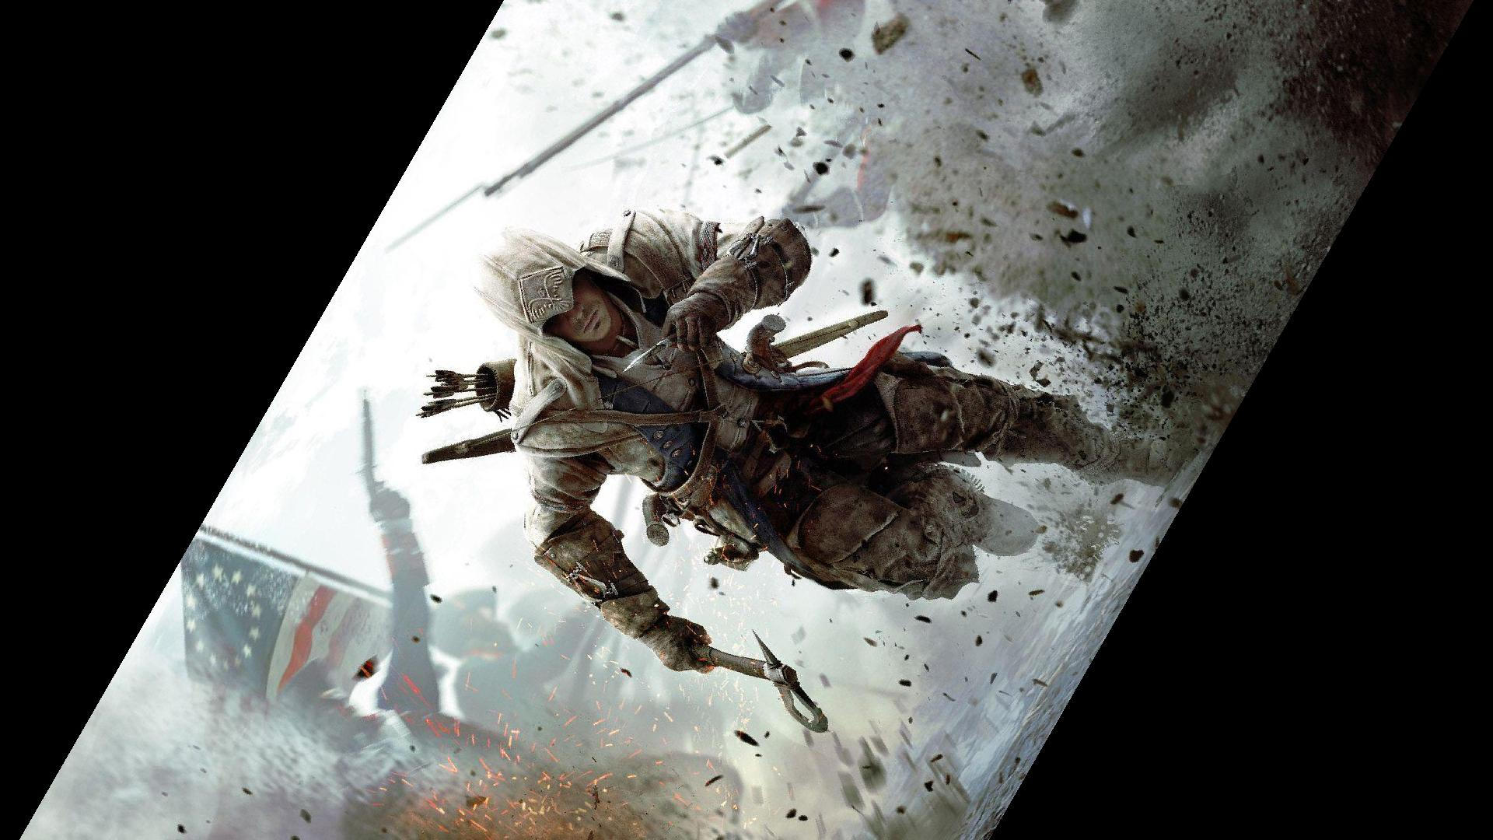
Screenshots or Outputs in Modify Window
Resize
Rotate: 60 degrees

Slide 12
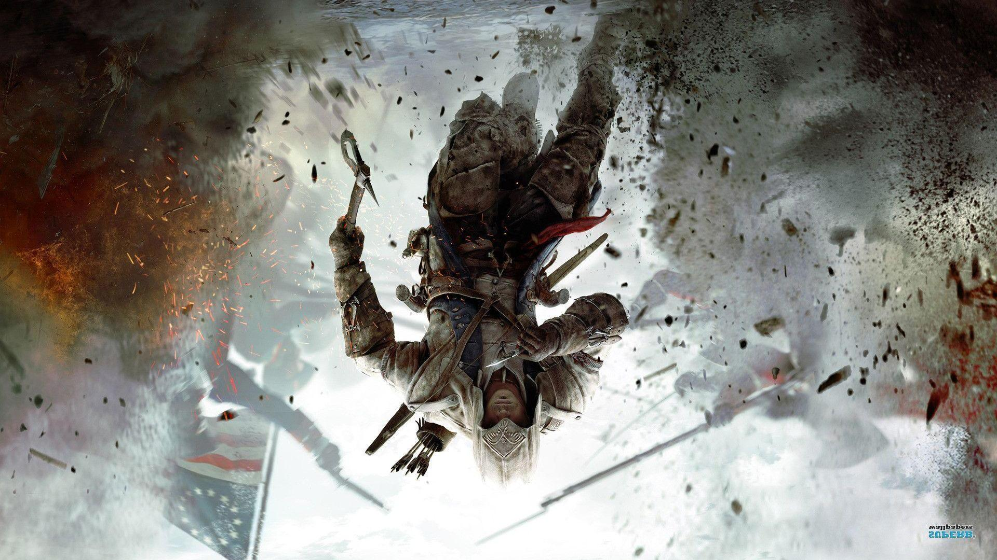
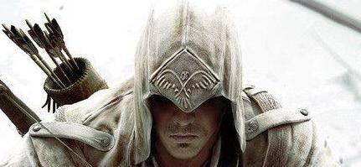
Screenshots or Outputs in Modify Window
Flip
Crop

Slide 13



TEAM
G.VARUN KUMAR
18R11A0511
GEETHANJALI COLLEGE OF ENGINEERING AND TECHNOLOGY
K.NITHESH SAI
18R11A0515
GEETHANJALI COLLEGE OF ENGINEERING AND TECHNOLOGY
L.JAYA KRISHNA
18R11A0524
GEETHANJALI COLLEGE OF ENGINEERING AND TECHNOLOGY

Slide 14


